Slide 1
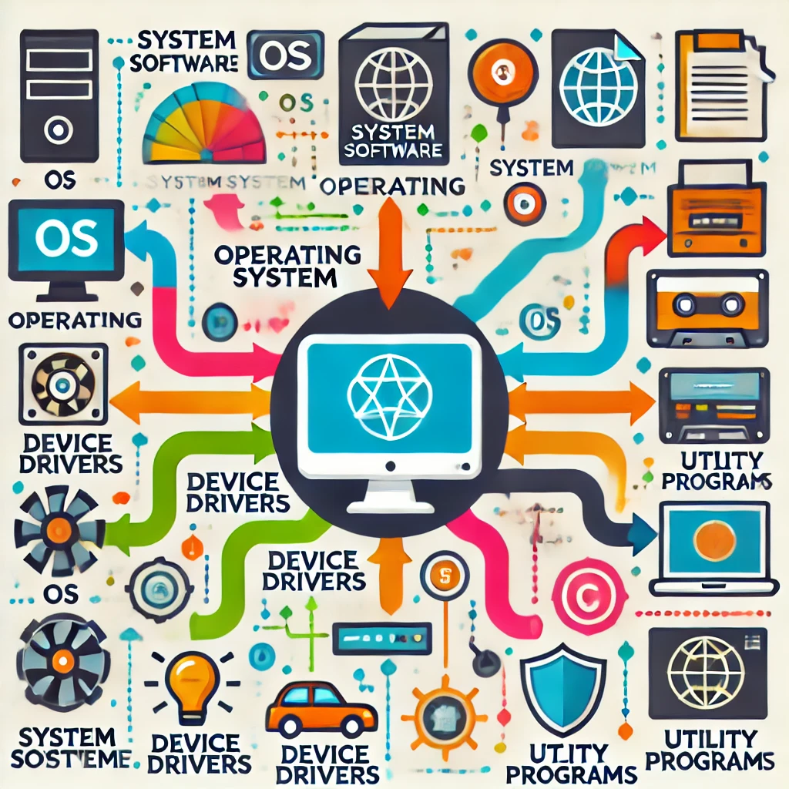
System Software
-By : Safar Bhandari

Slide 2

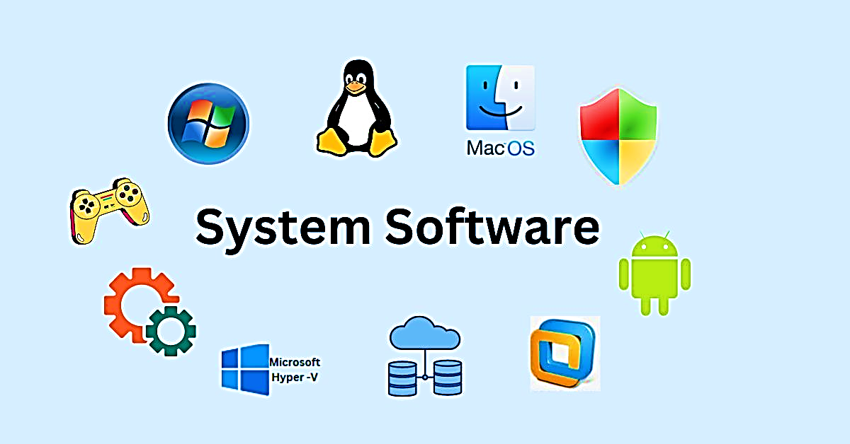
What is system software??
It is a type of software that helps run computer hardware and allows application software to work.
It manages and controls computer resources like CPU, memory and storage.
For e.g.: Operating system. Device drivers etc.

Slide 3

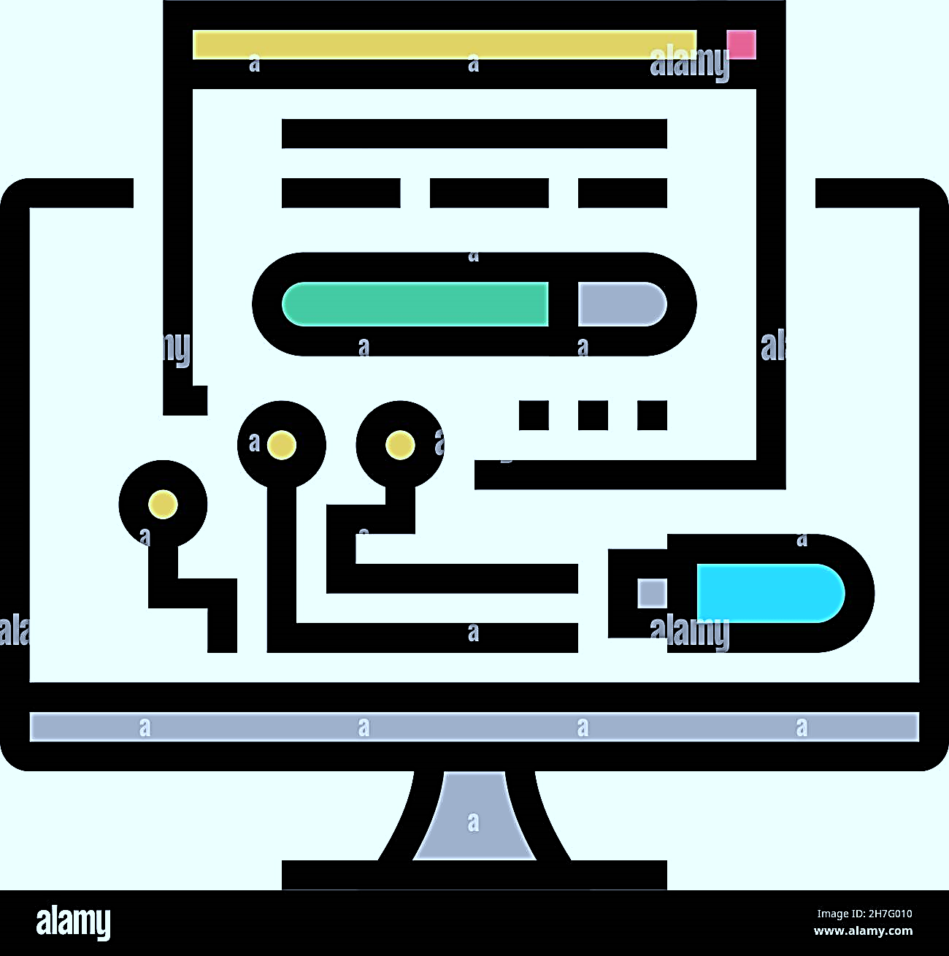

Types of System Software
1. Operating System
2. Device Drivers
3. Utility Programs
Manages everything on your computer like Windows or macOS.
Help your computer talk to hardware like printers or speakers.
Help keep your computer clean and running smoothly.(e.g. antivirus software , disk cleanup)

Slide 4

Functions of system software
Resource Management: Allocates systems resources.
Process Management: Manages the execution of processes,
multitasking and scheduling.
Memory Management: Tracks and optimizes the use of memory.
Security and Access control: Protects against unauthorized access to
data and resources.

Slide 5
Importance of system software
1. Enables user application to run efficiently.
2. Optimizes hardware performance and resource allocation.
3. Ensures system stability, security and reliability.
4. Allows users to interact with computer through the operating system

Slide 6
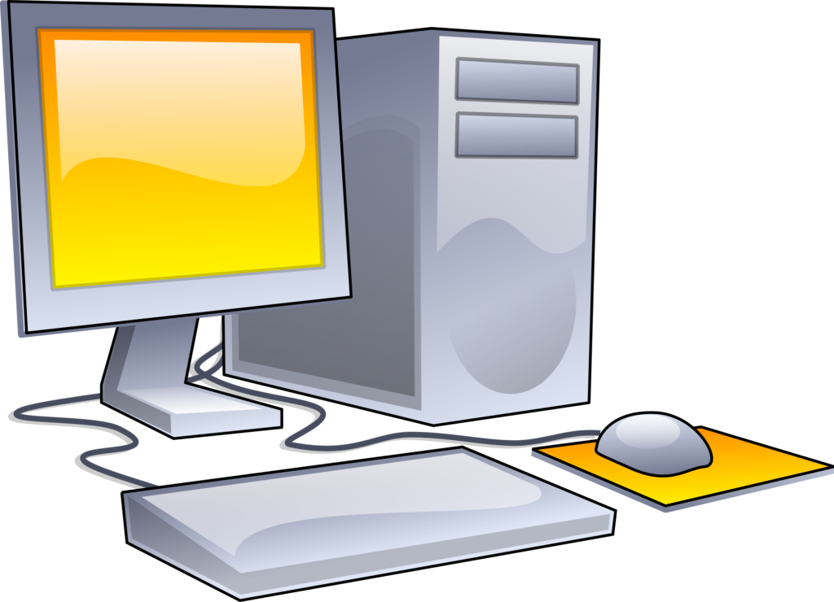

Conclusion
System software is essential for the operation of computer systems and applications.
The development of system software continues to evolve to meet the demands of modern hardware and technology.

Slide 7
Thank you

